Slide 1
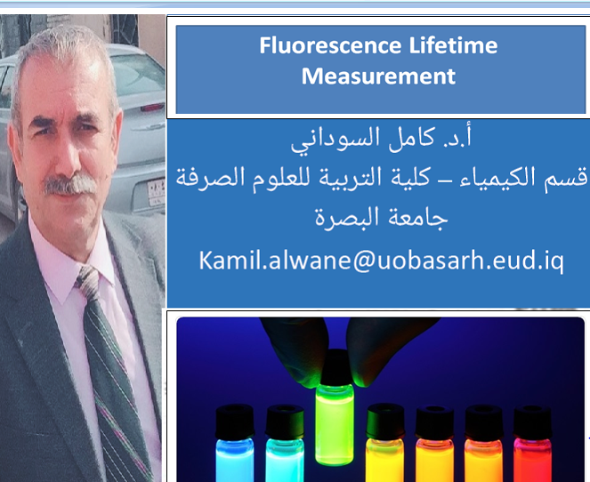

Slide 2
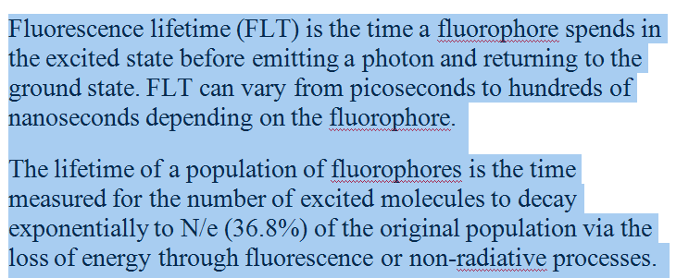
Introduction

Slide 3
Fluorescence lifetime is an intrinsic property of a fluorophore
FLT does not depend on fluorophore concentration, absorption by the sample, sample thickness, method of measurement, fluorescence intensity, photo-bleaching, and/or excitation intensity. It is affected by external factors, such as temperature, polarity, and the presence of fluorescence quenchers. Fluorescence lifetime is sensitive to internal factors that are dependent on fluorophore structure.¹

Slide 4
Fluorescence lifetime can be measured
The frequency domain
The time domain.

Slide 5
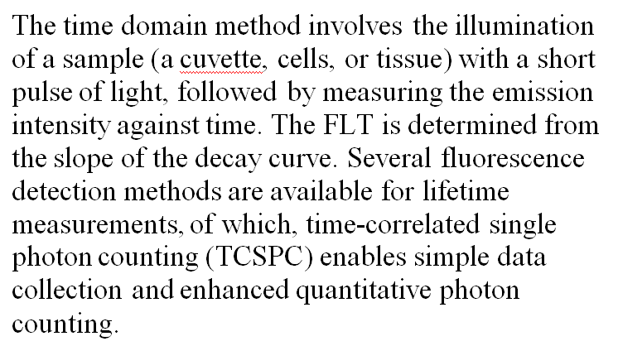
The frequency domain

Slide 6
The frequency domain
The frequency domain method involves the sinusoidal modulation of the incident light at high frequencies. In this method, the emission occurs at the same frequency as the incident light accompanied with a phase delay and change in the amplitude relative to the excitation light (demodulation).

Slide 7
Advantages of Fluorescence Lifetime Measurement Over Intensity-based Measurement²
The lifetime method expands the sensitivity of the analyte concentration range by the use of probes with spectral shifts.
Lifetime measurements may be used for analytes for which there are no direct probes. These analytes include glucose, antigens, or any affinity or immunoassays based on fluorescence energy transfer transduction mechanism.
Lifetime measurements do not require wavelength-ratiometric probes to provide quantitative determination of many analytes.

